Slide 1
Use of Restricted Mudharaba Contract in Wholesale Finance to MFIs
March 2022

Slide 2
The Sudanese Microfinance Development Facility (SMDF) Co.Ltd has been established as an (Apex) institution in 2009, and it is owned by Ministry of Finance (M o F) and Central Bank of Sudan (CBOS) to provide Technical and financial support to existing and new Microfinance Institutions (MFIs) operating in the country.
The complementary role of SMDF is aiming at help MFIs to operate and sustain through providing them with many packages of technical and financial support.

Slide 3
Vision
:
To be the leading Apex institution in The Sudan

Slide 4
Mission
Enhancing the capacities of MFIs through providing technical and financial support to achieve their sustainability using effective and efficient operations in order to include economically active poor in the formal economic cycle.

Slide 5
Financial Support
1
2
3
4
Wholesale Finance Through Restricted Mudharaba
Equity Participation
Partnerships with Regional and International Donors and Funders
Multi- Funders portfolio Management

Slide 6
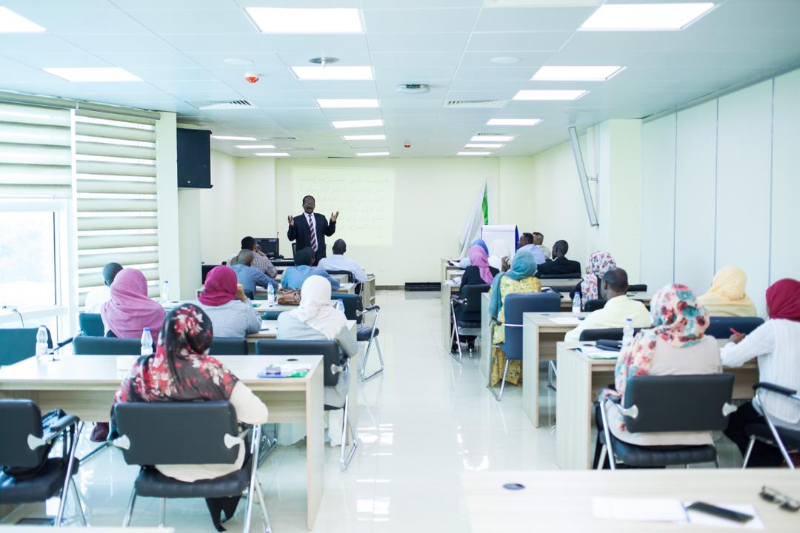
Technical Support
1.
Loan Tracking System (LTS)
2.
External and Internal specialized training sessions and workshops.
3.
Studies, researches and consultancy services.

Slide 7
Main Indicators (Accu. Dec 2021)
Targeted States
Equity Participated MFIs
16
3
Wholesale Finance Contracts
Financed MFIs
73
27

Slide 8
1.
Clients
153,000
36
2.
LTS Users
1,000
3.
Trained MFIs Staff

Slide 9
Partners
ISDB
AMF
WFP
World
Bank
UNDP
UNIDO

Slide 10
RESTRICTED MUDHARABA CONTRACTS
Restricted Mudharaba is one of the Islamic modes of finance that are used to facilitate the access of MFIs in Sudan to Wholesale finance from Commercial banks and other sources. This contract has been introduced and developed by SMDF and the Microfinance Unit of Central Bank Of Sudan (MFU-CBOS). This contract facilitates the wholesale finance flow from different sources to MFIs and beneficiaries.

Slide 11
RESTRICTED MUDHARABA CONTRACTS
MAIN FEATURES:
It is a profit and loss sharing mode of finance.
It is the sole mode that can be used to finance the newly born MFIs with no credit history.
It helps Central Bank of Sudan to increase the amount of wholesale finance from commercial banks to MFIs to reach the allocated percentage of 12% of their portfolio (CBOS Policies).
The contract can help to achieve targeted outreach goals (geographical areas, activity sectors, gender, age, loan size,…etc).
It provides MFIs with a solid M&E tool to audit their performance periodically.

Slide 12
Thank You

